Slide 1
Resource Pack: Interaction IV Barriers and Access
© Melanie Baljko

Slide 2
Intellectual Property Notice
This presentation is protected by Canadian and international copyright laws. Reproduction and distribution of the presentation without the written permission of the copyright holder is prohibited.
These course materials are designed for use as part of the EECS3461 course at York University and are the intellectual property of the instructor unless otherwise stated. Third party copyrighted materials (such as book chapters, journal articles, music, videos, etc) have either been licensed for use in this course or fall under an exception or limitation in Canadian Copyright law.
Copying this material for distribution (e.g., uploading material to a commercial third-party website) may lead to a charge of misconduct under York’s Code of Student Rights and Responsibilities and the Senate Policy on Academic Honesty and/or legal consequences for violation of copyright law if copyright law has been violated.
© Melanie Baljko, 2021

Slide 3
Dependencies
This resource pack assumes that you are already familiar with:
R-Humans-III (and all previous)
R-Design-VIII (and all previous)
R-Interaction-III (and all previous)
R-Technosocial-I, R-Knowledge-I

Slide 4
Inquiry
Break down this resource pack into smaller pieces
1. What is a “curb-cut effect”?
2. What is meant by ‘accessible’ and ‘accessibility’?
3. How does accessibility relate to disability?
4. What is Universal Design and what are its principles?

Slide 5
1. What is a “curb-cut effect”?

Slide 6
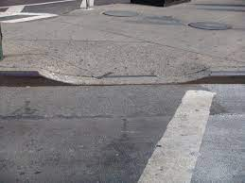
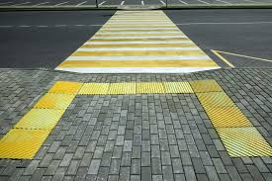
Examples of Curb Cuts

Slide 7
Curb Cuts
The Curb Cut Effect: How Making Public Spaces Accessible to People With Disabilities Helps Everyone
Disability Science Review, Emily Morson, Dec 2016
first installed starting after World War II (veterans)
originally designed to make public streets accessible to wheelchair users
the main curb cut movement started in the 1960’s, Berkeley activism (Rolling quads)
curb cuts are used by many:
Parents pushing strollers
People lugging heavy loads
Travelers wheeling luggage
Runners and skateboarders

Slide 8
the Curb Cut Effect
The Curb Cut Effect: How Making Public Spaces Accessible to People With Disabilities Helps Everyone
Disability Science Review, Emily Morson, Dec 2016
the curb cut effect:
when accessibility features come to be used and appreciated by a larger group than the people they were designed for
refers to a more general phenomenon of ‘mainstream use’
when the features become sufficiently ubiquitous and widely used, it starts to becomes “normal”

Slide 9
Examples of Curb Cut Effects
close captioning
elevator door time-out
land-lines and dial tones
Oxo good grips

Slide 10
2. What is meant by ‘accessible’ and ‘accessibility’?

Slide 11
Review: Relational Concepts
recall Gibson’s concept of an affordance
Affordances are all "action possibilities" latent in the environment, objectively measurable and independent of the individual's ability to recognize them
recall how we contrasted:
affordance as a relational concept
e.g., Gibson’s characterization
affordance as property
e.g., the misused version, which was the result of practitioners mistaken interpretations of Norman’s book)
action possibilities exist in relation to an individual, not as a possibility that is independent of the individual
thus, the concept of an affordance is a relational

Slide 12
Accessible
“this {building|app|program|piece of equipment} is/is not accessible”
the accessibility or inaccessibility of something is relational
accessible refers to the property of something as ‘being able to be used by a person’
accessible applies in a wide variety of situations:
information and communication technologies (ICT)
the build environment
civic processes (e.g., voting, government services)
medicine
education

Slide 13
Accessibility and Usability
accessibility and usability are interrelated concepts
usability tends to assume ‘specific users’, often based on the normate (which we will discuss further)

Slide 14
2. What is meant by ‘accessible’ and ‘accessibility’?

Slide 15
Review: Product ‘Scripts’
recall what we discussed earlier about product ‘scripts’
Madeleine Akrich (1992) developed the concept of the "script" as a metaphor for the "instruction manual" that is “inscribed” in an artifact
Any artifact contains a "message" (the script) from the producer/designer to the user describing the product's intended use and meaning
the product script might be legible to some people, but not others, depends on social factors
‘Mainstream’ design can be understood as a process that results in a particular framework of action (Akrich, 1992)
to what extent can this the ‘framework of action’ be performed by a person?

Slide 16
Direct and Indirect Access
if a person is able to perform the ‘framework of action’ inscribed in a design artefact, this is often called direct access
if a person is not able to perform the ‘framework of action’ inscribed in a design artefact through the use of additional technology, this is often called indirect access
this additional technology is very often called assistive technology

Slide 17
Example: html content
html content deployed on the web
this is a mainstream design technique
the inscribed framework of action is to open and engage with the content using a web-based client
the mainstream version of this is to engage visually and to perform motor input actions
this is direct access
some users employ additional technologies to circumvent barriers to using a mainstream web browser
screen reader software
input interface software (eye tracking, switch-based input)
this is indirect access

Slide 18
Illustration
Screen Reader Demo for Digital Accessibility
https://www.youtube.com/watch?v=dEbl5jvLKGQ
Assistive Technology During a Pandemic: Empowering people with disabilities
https://www.youtube.com/watch?v=TD6nQeNbmL8

Slide 19
3. How does accessibility relate to disability?

Slide 20
Characterizing Disability, II
“The meaning of disability, like the meaning of illness, is presumed to be self-evident; we all know it when we see it. But the meanings of illness and disability are not nearly so fixed or monolithic; multiple understandings of disability exist.” [Kafer, 2013]

Slide 21
Multiple Understandings of Disability
the different ‘understandings’ of disability are typically referred to as models
Here are some of the prominent models
charity model
medical model
social model
biopsychosocial model
political/relational model

Slide 22
The Medical Model of Disability
This model holds that:
Disability is a deficiency or abnormality
Disability is perceived as negative; being disabled is a negative attribute
Disability is a feature of a person’s health condition
an individual's experience of disability arises from that feature
medical care is required, want to cure
failing a cure, then correct to the greatest extent possible
in general, there is a “problem” with the individual that must be “corrected” [WHO, 2002]

Slide 23
The Charity Model of Disability
An offshoot of the medical model
disability is something in the body that can and should be cured.
creates a view of disabled people's lives as tragic and pitiable
connected to the ‘supercrip’ narrative;
someone who overcomes their disability in ways that are often seen by the public as inspiring.

Slide 24
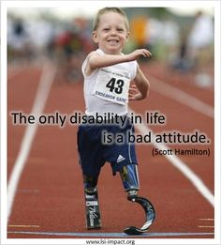
Example: supercrip narrative

Slide 25
The ‘supercrip’ narrative
The ‘supercrip’ narrative;
someone who overcomes their disability in ways that are often seen by the public as inspiring.
a stereotype narrative displaying the plot of someone who has “to fight against his/her impairment” in order to overcome it and achieve unlikely “success.”
a type of ‘inspiration porn’
is a form of ableism
holds a negative ethos of disability
glorifies any achievement, no matter how insignificant; feeds low expectations
portrays people with disabilities as “one-dimensional saints who only exist to warm the hearts and open the minds of able-bodied people”

Slide 26
The Social Model
The Social Model holds:
Disability is not a deficiency or abnormality; it is a difference
Disability is perceived as neutral; being disabled is a neutral attribute
It is not the individual who has the disability; the disability is created by society.
The social model of disability holds disability to be a socially-created condition rather than an attribute of an individual [Hughes and Paterson, 1997, p. 328].
The implication is that the issues of disability do not have their locus on the individual but instead in society.

Slide 27
“... In our view, it is society which disables physically impaired people. Disability is something imposed on top of our impairments by the way we are unnecessarily isolated and excluded from full participation in society. Disabled people are therefore an oppressed group in society…" (Oliver, 1996, 22)

Slide 28
Characterizing Disability, Medical Model
…Disability activists and advocates have been trying to frame disability and surrounding issues using a social model of disability since at least the 1980s in an effort to distance discourse from the (still) predominant medical model…
[1] http://www.gimpgirl.com/2011/11/24/social-vs-medical-model-evolved/

Slide 29
The Biopsychosocial Model
The biopsychosocial model originates from the WHO, and the International Classification of Functioning, Disability and Health (ICF)
the ICF is a classification of the health components of functioning
created 1980, revised in 2001
also a child and youth version (ICF-CY) which captures aspects of functioning that relate to development
The ICF does not use the term functional impairment, but rather just the term functioning (as a noun)

Slide 30
The Biopsychosocial Model
A person's functioning in seen neutrally and encompass all of that individual's body functions, activities and involvement in life situations.
A person’s functioning can be viewed from three levels:
body or body part (biological),
the whole person (individual), and
the whole person in a social context (social)
Decrements in functioning are (similarly) viewed from three levels:
a decrement in functioning at the body or body part level (biological) is termed an impairment
a decrement in functioning at the person level is an activity limitation
a decrement in functioning at the societal level is a participation restriction

Slide 31
Emergence of the Normate, I
[Hamraie, 2012]
starting in the 19th century, the possibility was created to quantify the “average man”
the rise of anthropometry (the scientific study of the measurements and proportions of the human body)
the rise of scientific measurement
shifting epistemological stances
e.g., Quetelet, first application of statistics to social science
from this, statistical means arose
average height, weight, strength, suicide rates, etc, etc
BUT… the concept of a ‘statistical mean’ came to be conflated with the concept of a ‘norm’

Slide 32
Emergence of the Normate, II
[Hamraie, 2012]
In the early 20th century, the US military began touse anthropometrics for the ergonomic design of cockpits and weapons (Wickens and Hollands 2000)
Eventually anthropometric data and ergonomics entered industrial design and civilian product design as evidence about potential users.
This collection of evidence came to form the normate template

Slide 33
The Normate
the normate is the position of identity held by those unmarked by stigmatized identifiers of disability
it is the imagined "everyday" person whose self-determination, independence, rational thinking ability, and physical sturdiness makes our society philosophically possible
Rosemarie Garland Thomson, Extraordinary Bodies, 1997, Columbia University Press

Slide 34
Political/relational model
[Kafer, 2013]
rejects the idea that disability as a purely medical “problem” of the body/mind
foregrounds issues around non-normative bodies and the normate template
this model seeks to makes legible how social and architectural barriers can alienate non-normative bodies
holds that disability is a political site that is ever-changing and always in relation to other people, environments, and attitudes

Slide 35
How does accessibility relate to disability?
oftentimes, accessibility and assistive technology are described in terms of disability
“Accessibility refers to the design of products, devices, services, or environments so as to be usable by people with disabilities.”
“Assistive technology is technology used by individuals with disabilities”
this is problematic
the experience of and the attribution of disability is contested; multiple understandings of disability exist
raises the question: can accessibility be characterized without making use of the concept of disability?

Slide 36
4. What is Universal Design and what are its principles?

Slide 37
Universal Design, the Lead up
[Hamraie, 2012]
a new research strategy arose to challenge the normate template
it began as a regime to make excluded bodies apparent to designers and also to shift the way design research was conducted
Selwyn Goldsmith, a British architect published Designing for the Disabled (1963) “as a model for incorporating anthropometric data about people with disabilities into design as a corrective to existing data sets”
later, Ronald L. Mace, an American architect, coined the term Universal Design in the 1970’s, a term that has now became very well-established

Slide 38
Universal Design (UD)
[Hamraie, 2012]
UD was first used to describe the socially inclusive design practices that were starting to emerge in the 1970’s
these design practices privileged users in the design process rather than making them secondary to aesthetic or formal considerations
UD challenged the conventional approach of designing for the average user
UD poses the challenge to designing all products and the built environment to be aesthetic and usable to the greatest extent possible by everyone, regardless of their age, ability, or status in life [1]
[1] http://www.ncsu.edu/ncsu/design/cud/about_us/usronmace.htm

Slide 39
UD: Built Environment vs IT
The principles of UD can be applied to
built environment
products and services
technology/ICT
We will first discuss each UD principles as it applies to the built environment

Slide 40
Universal Design (UD) Principles
Source for following images and test
NC State University 7 Principles of Design Poster
http://universaldesign.ie/What-is-Universal-Design/The-7-Principles/
Zheng (2020), Learn to Create Accessible Websites with the Principles of Universal Design, Interaction Design Foundation
https://www.interaction-design.org/literature/article/learn-to-create-accessible-websites-with-the-principles-of-universal-design
[1] http://www.ncsu.edu/ncsu/design/cud/about_us/usronmace.htm
[2] http://universaldesign.ie/What-is-Universal-Design/The-7-Principles/

Slide 41
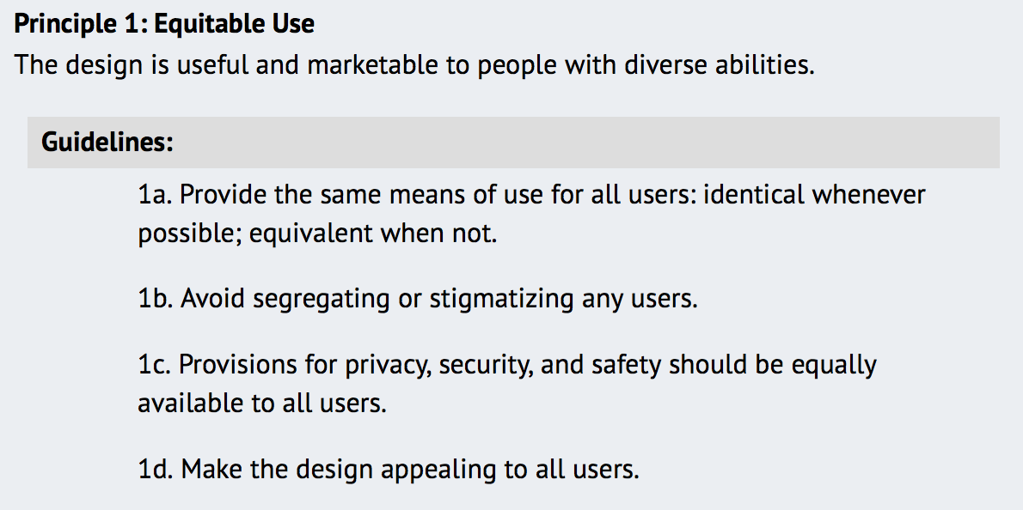
Principles of UD

Slide 42
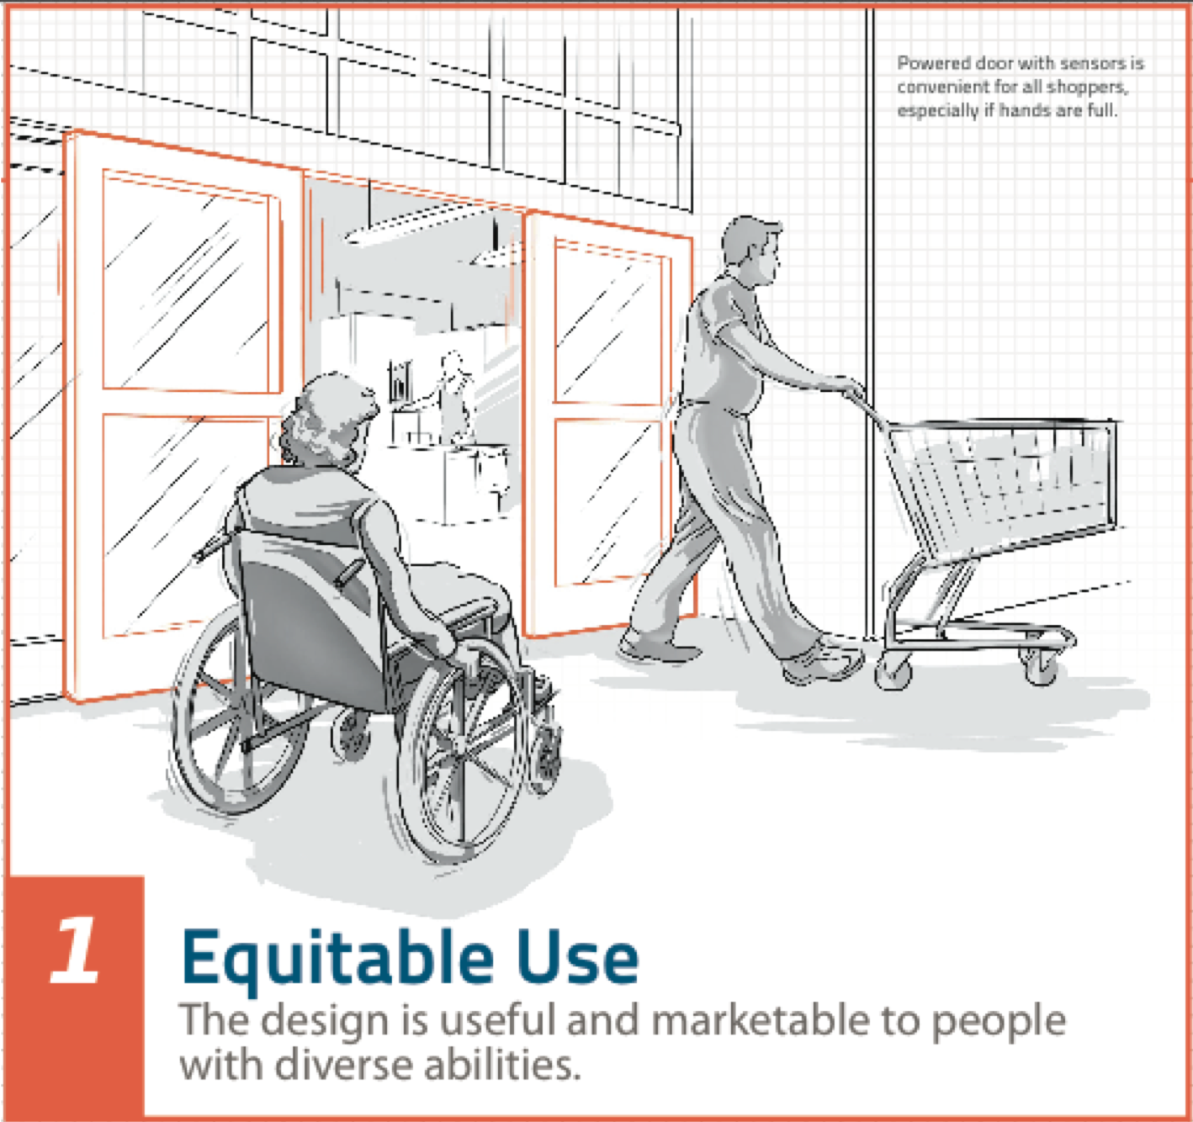
Principles of UD

Slide 43
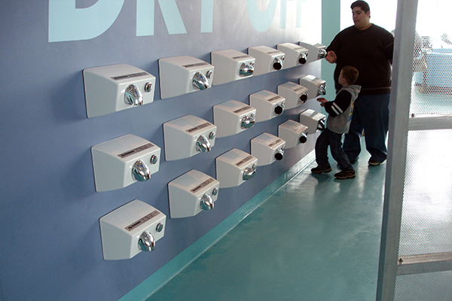

Slide 44
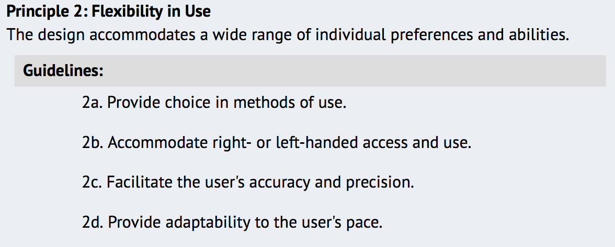
Principles of UD

Slide 45
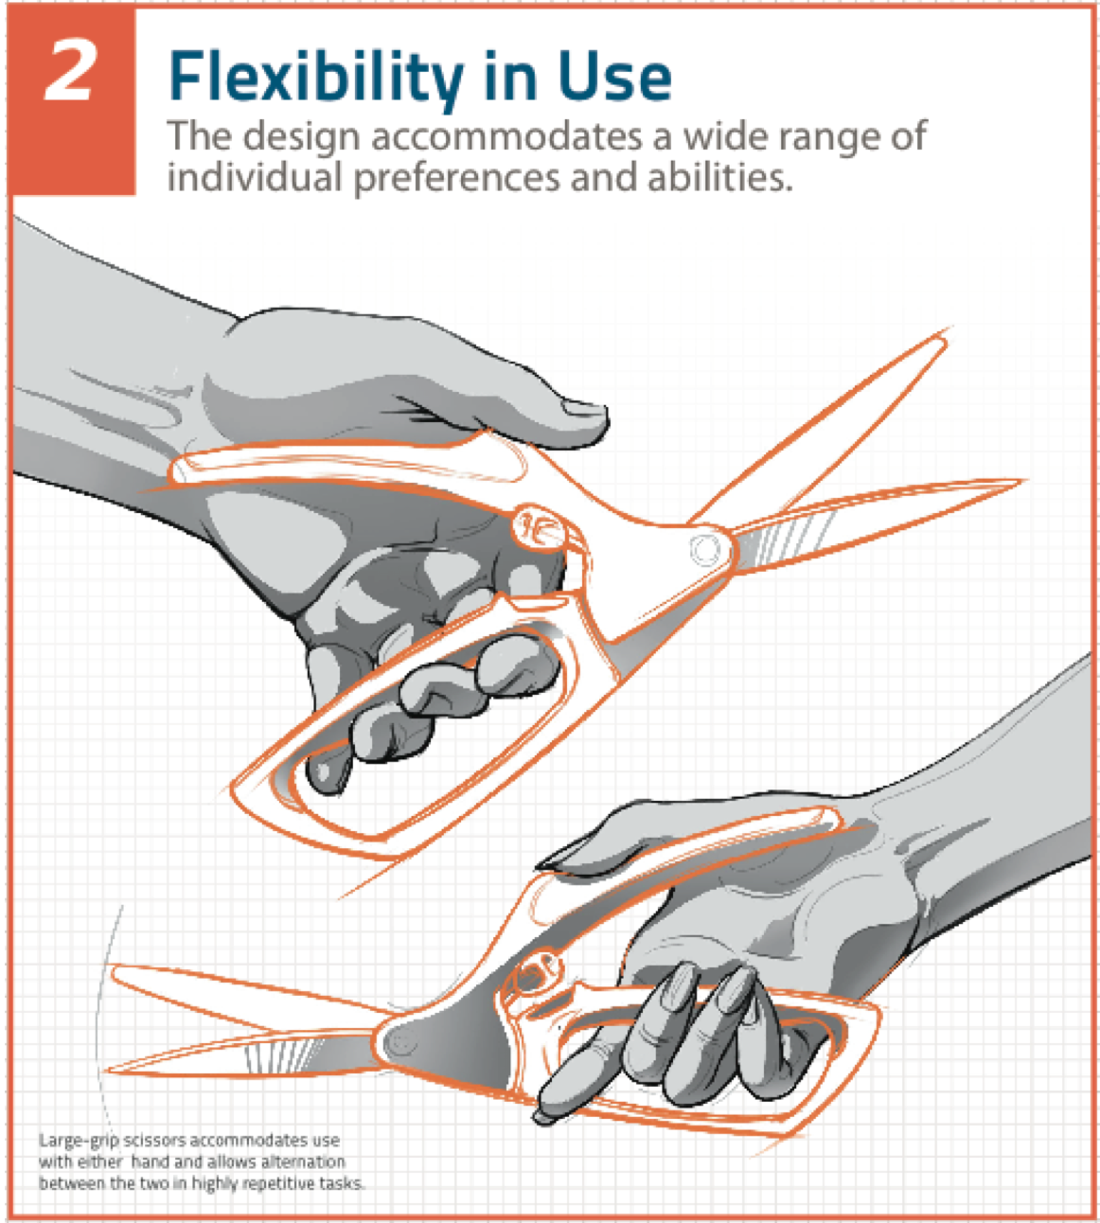
Principles of UD

Slide 46
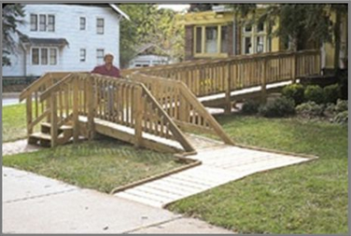

Slide 47


Slide 48
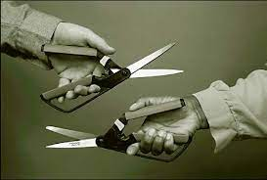

Slide 49
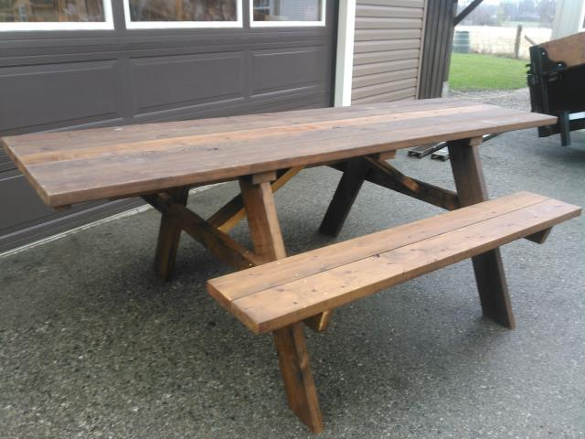

Slide 50
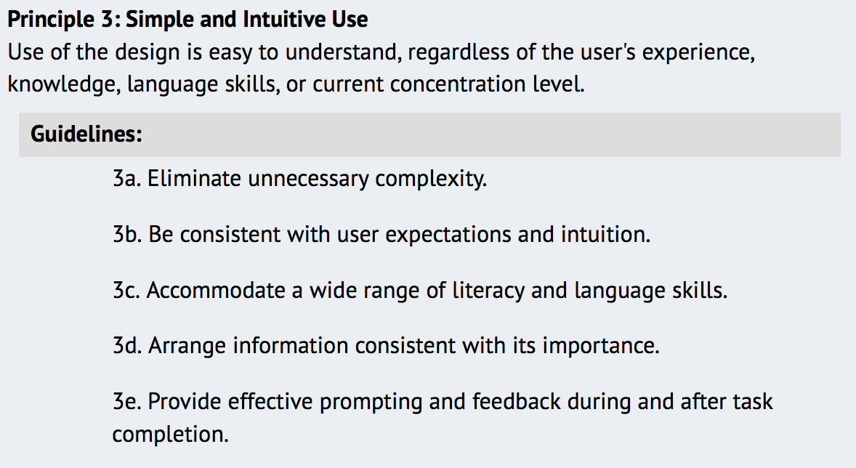
Principles of UD

Slide 51
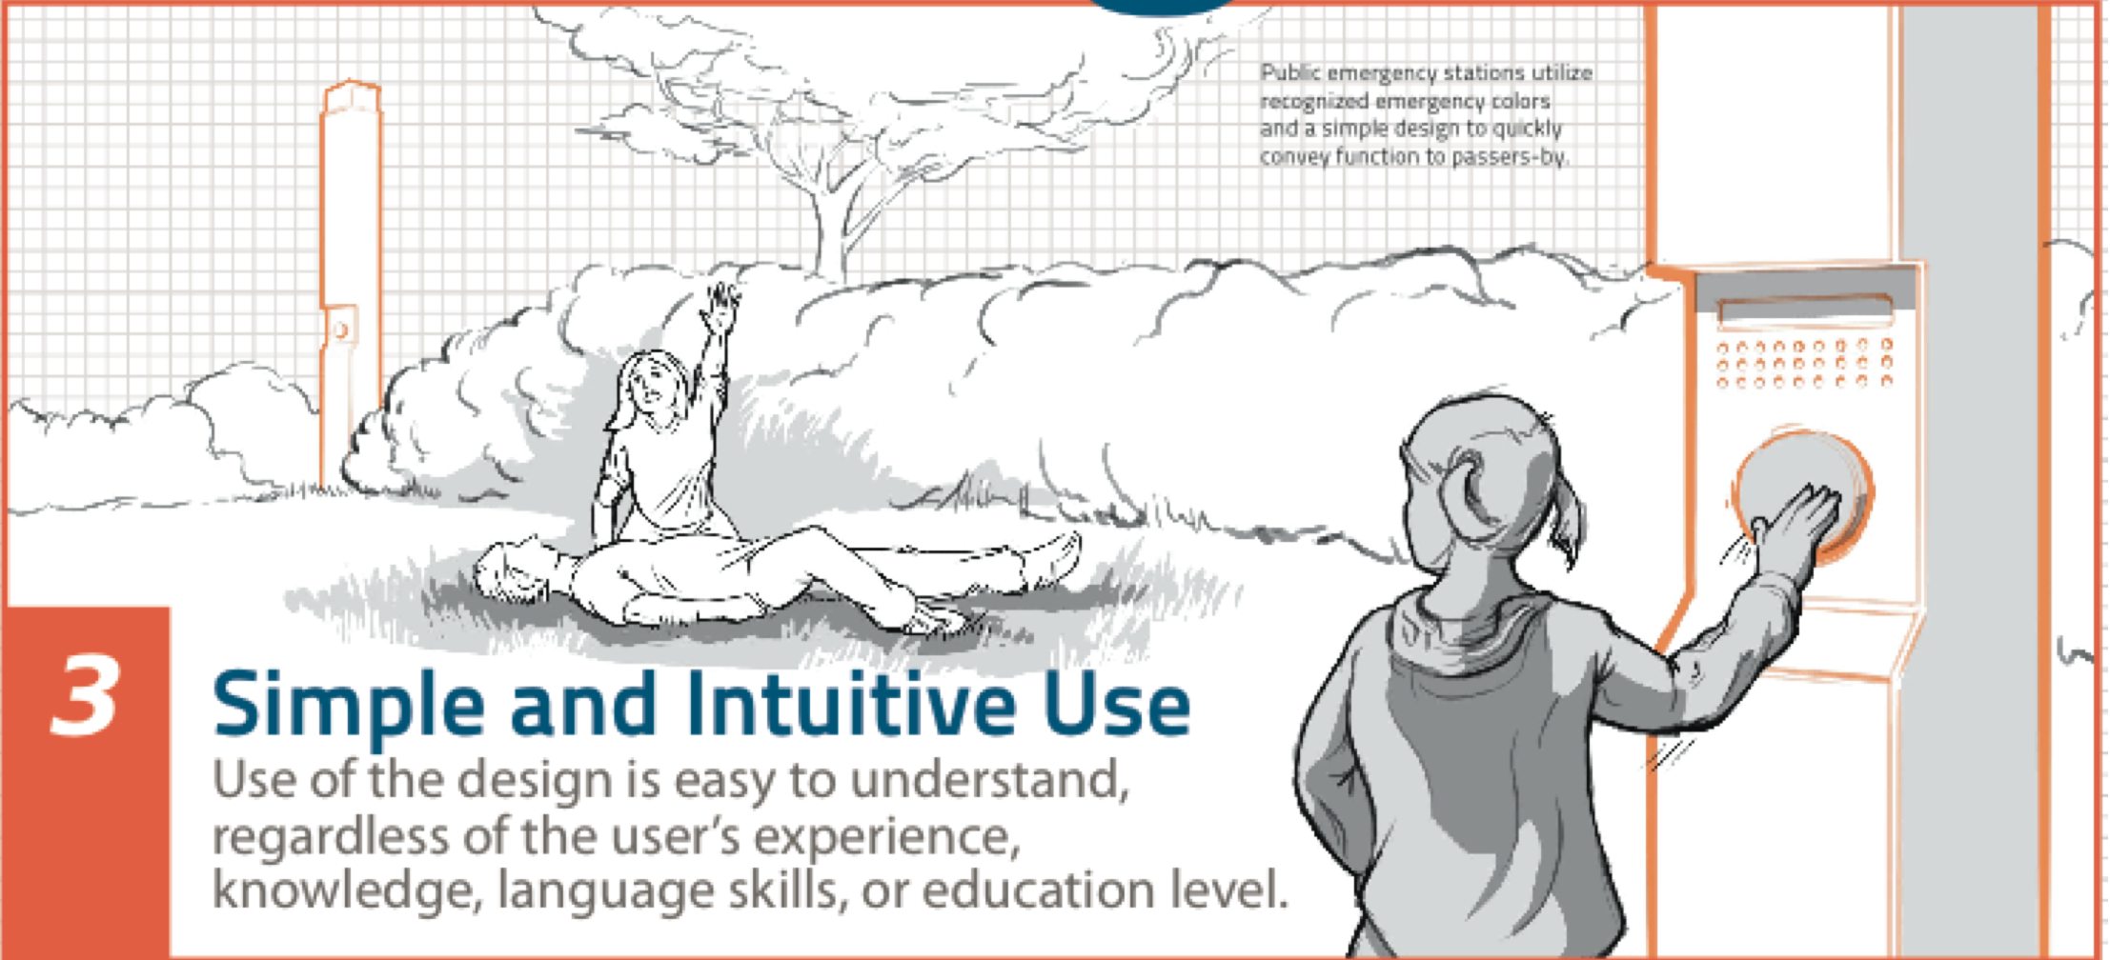
Principles of UD

Slide 52
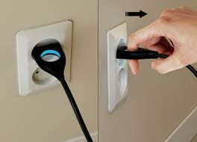

Slide 53
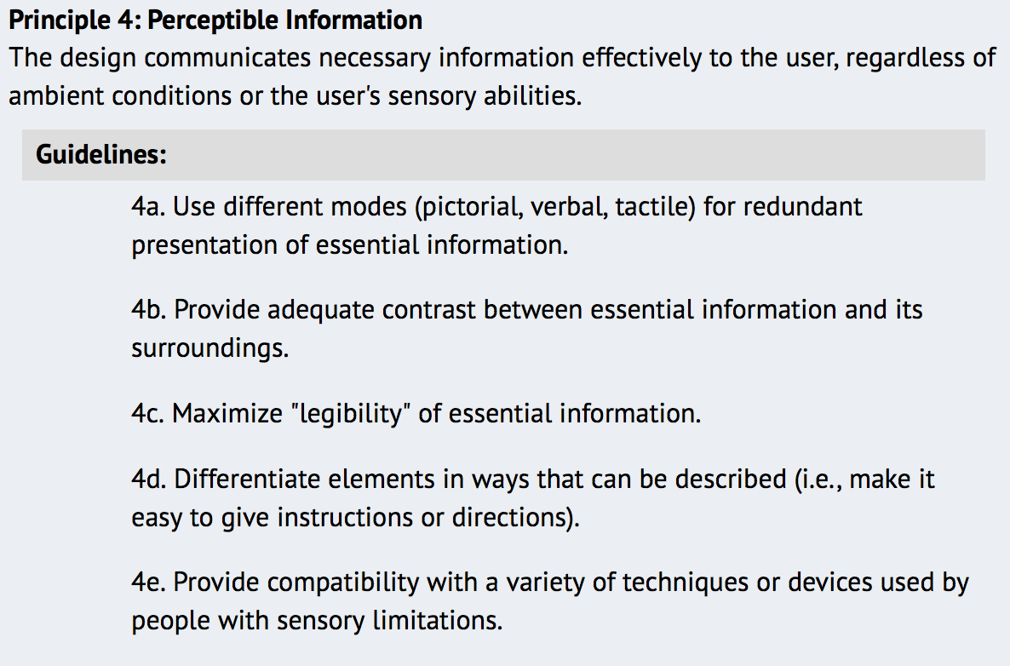
Principles of UD

Slide 54
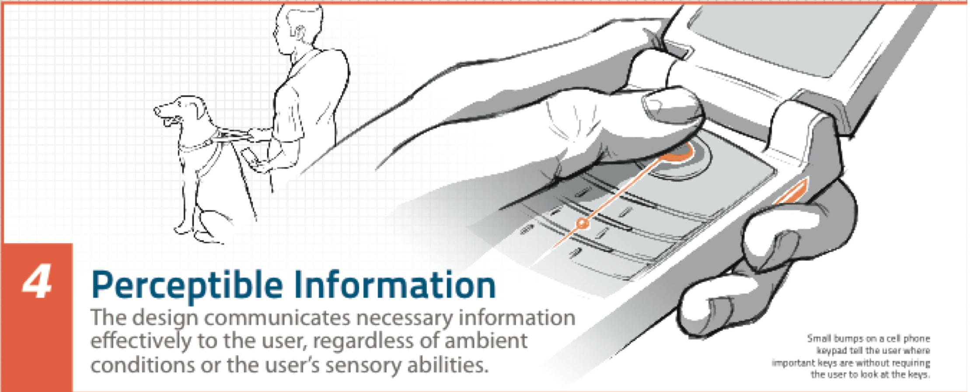
Principles of UD

Slide 55
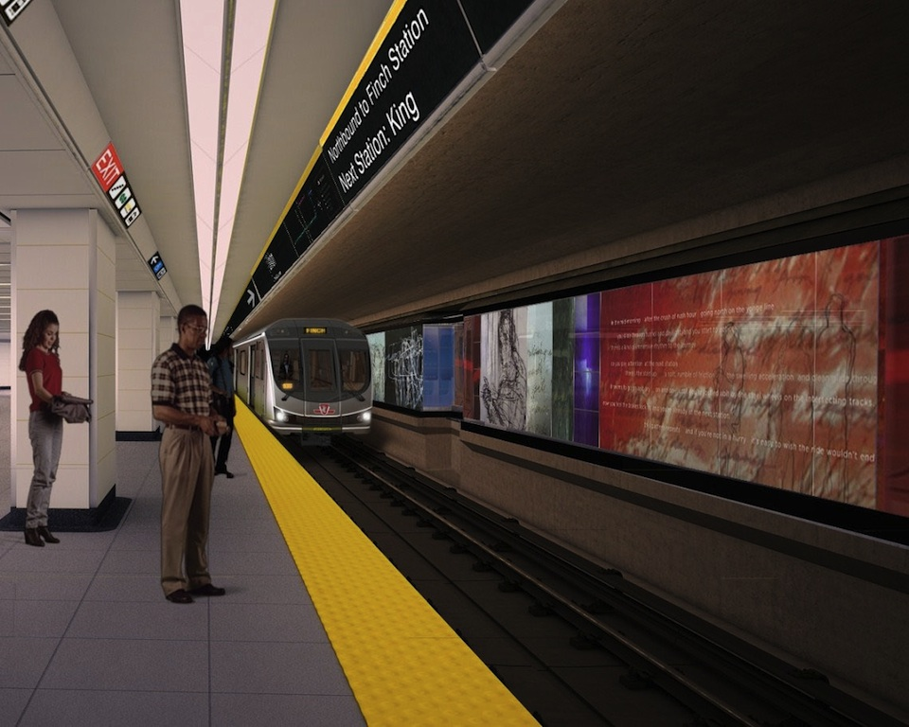

Slide 56
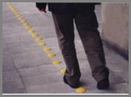

Slide 57
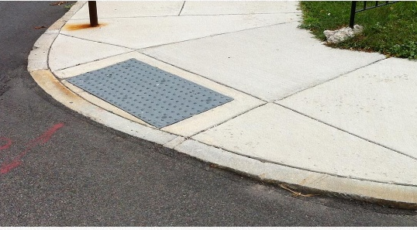

Slide 58
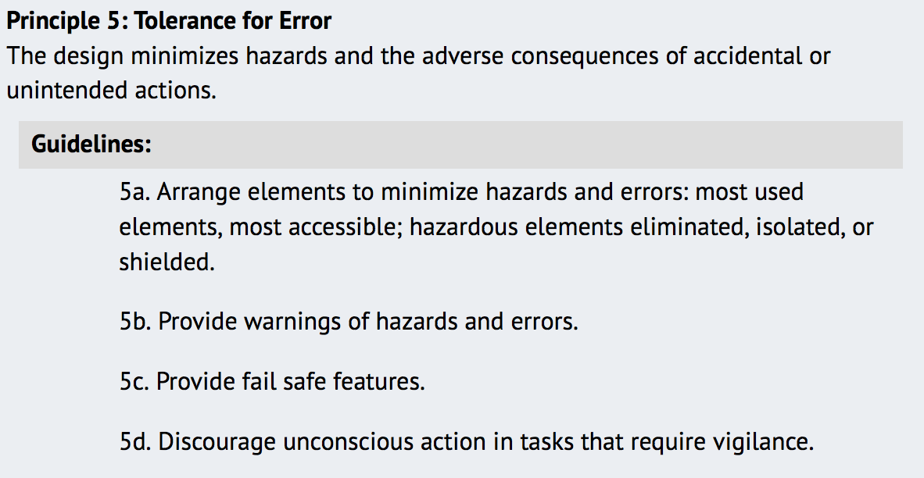
Principles of UD

Slide 59
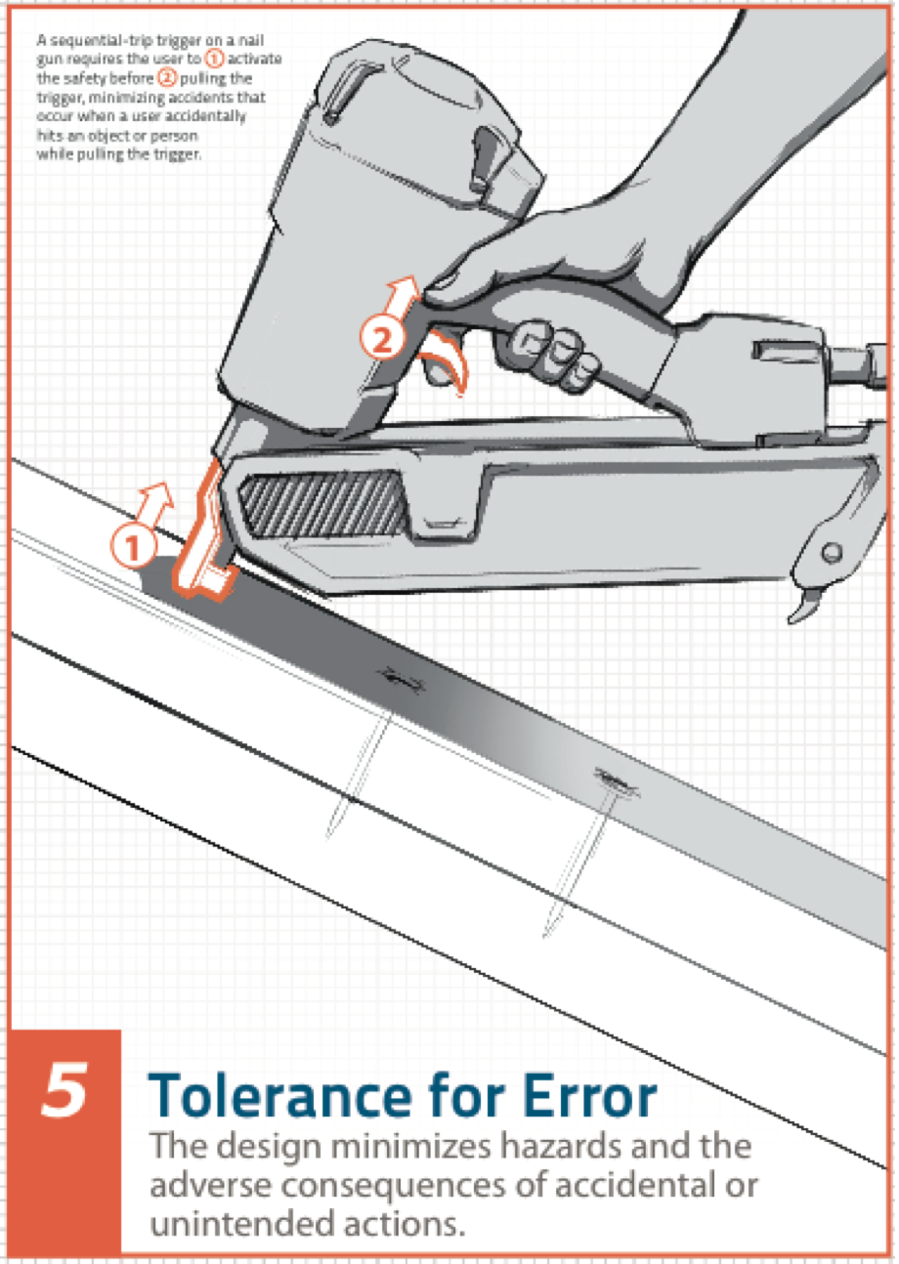
Principles of UD

Slide 60
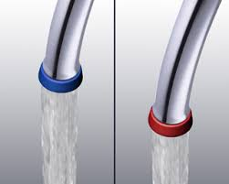

Slide 61
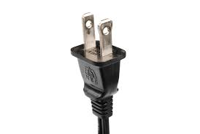

Slide 62
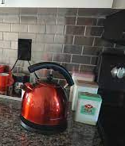
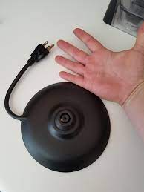

Slide 63
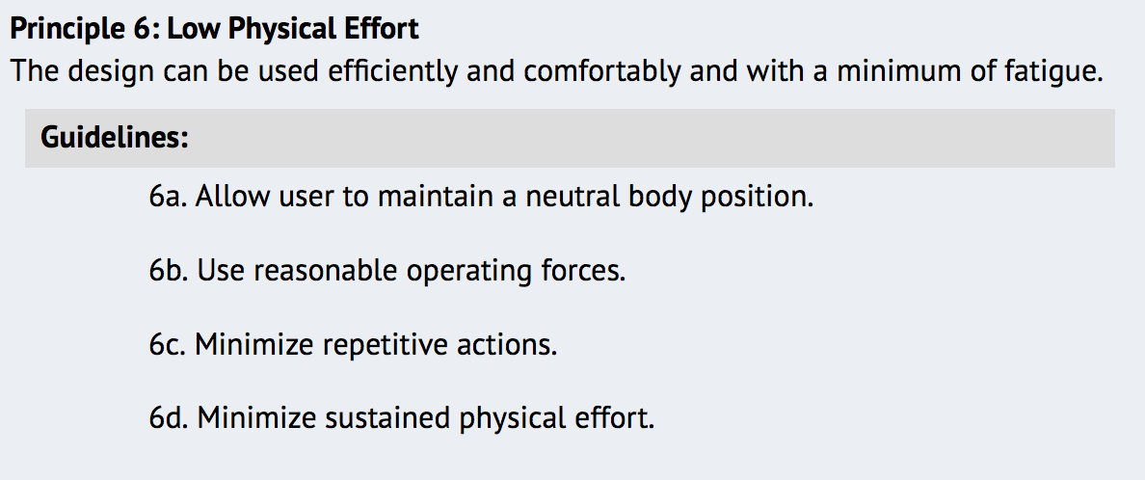
Principles of UD

Slide 64
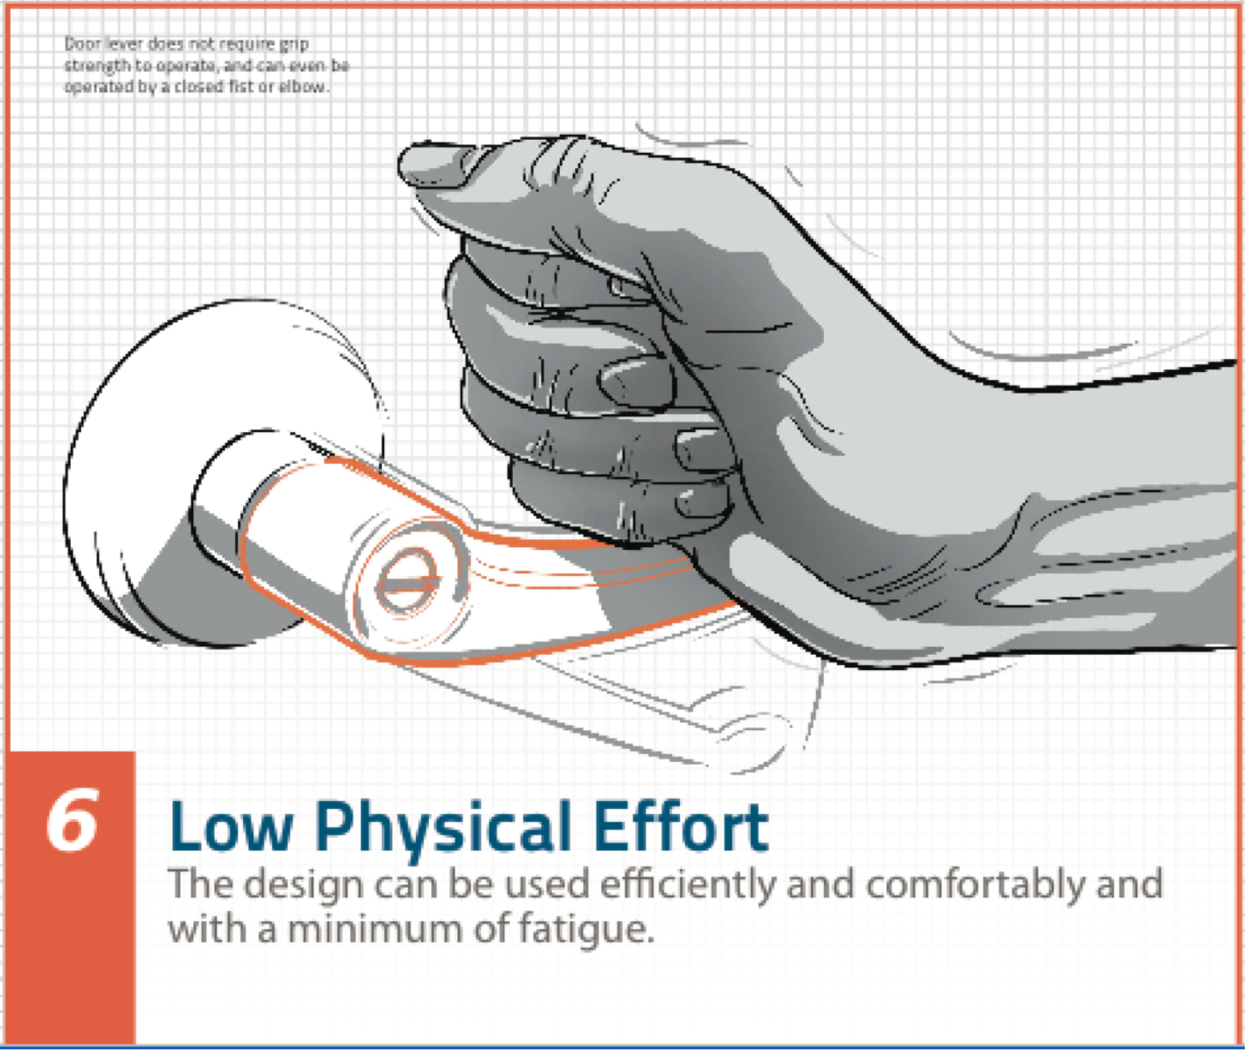
Principles of UD

Slide 65



Slide 66
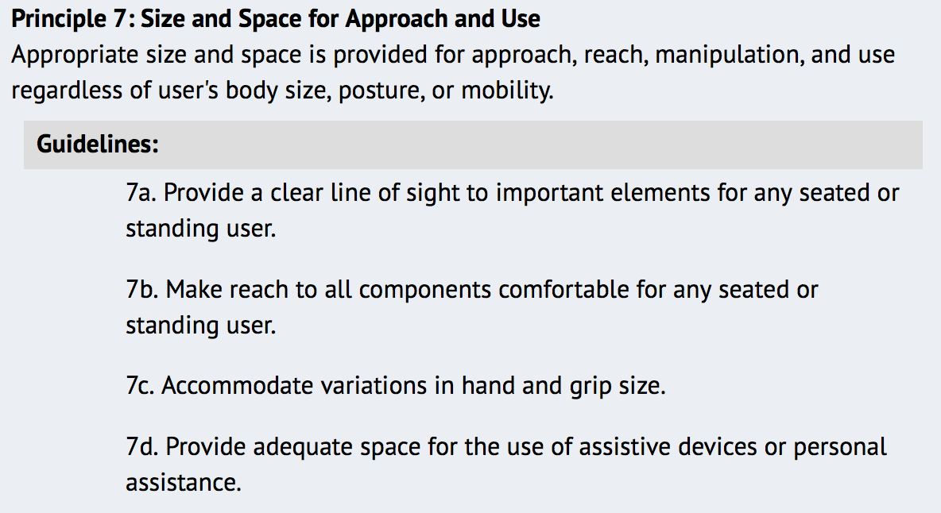
Principles of UD

Slide 67
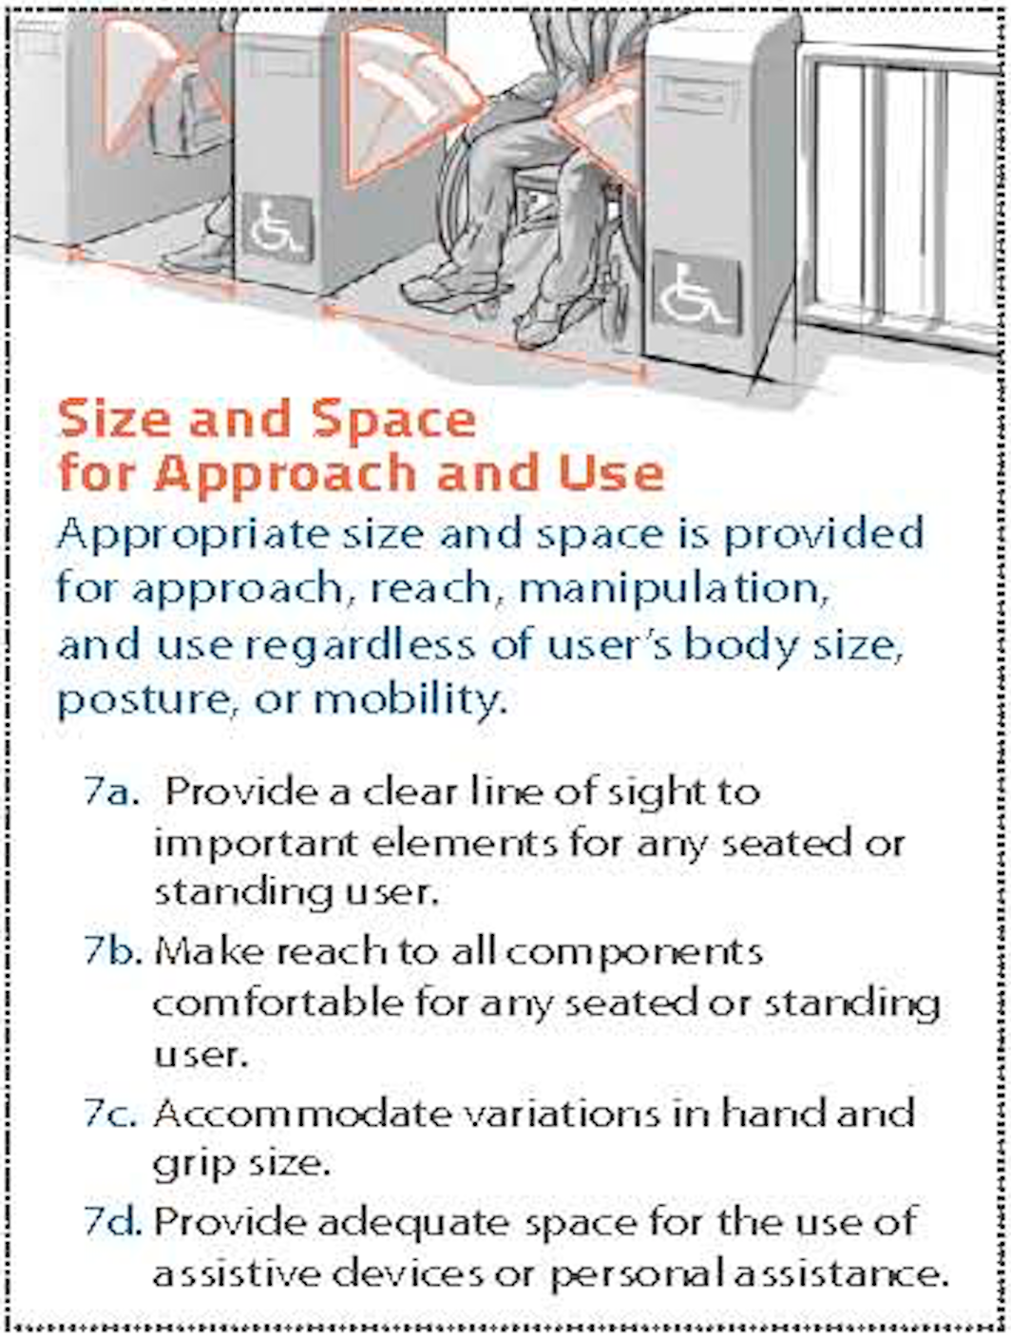
Principles of UD

Slide 68
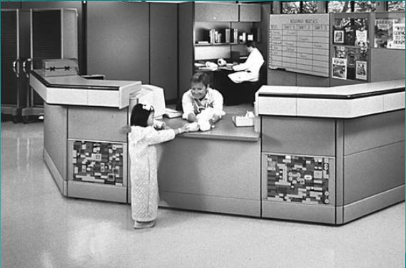

Slide 69
